Slide 1
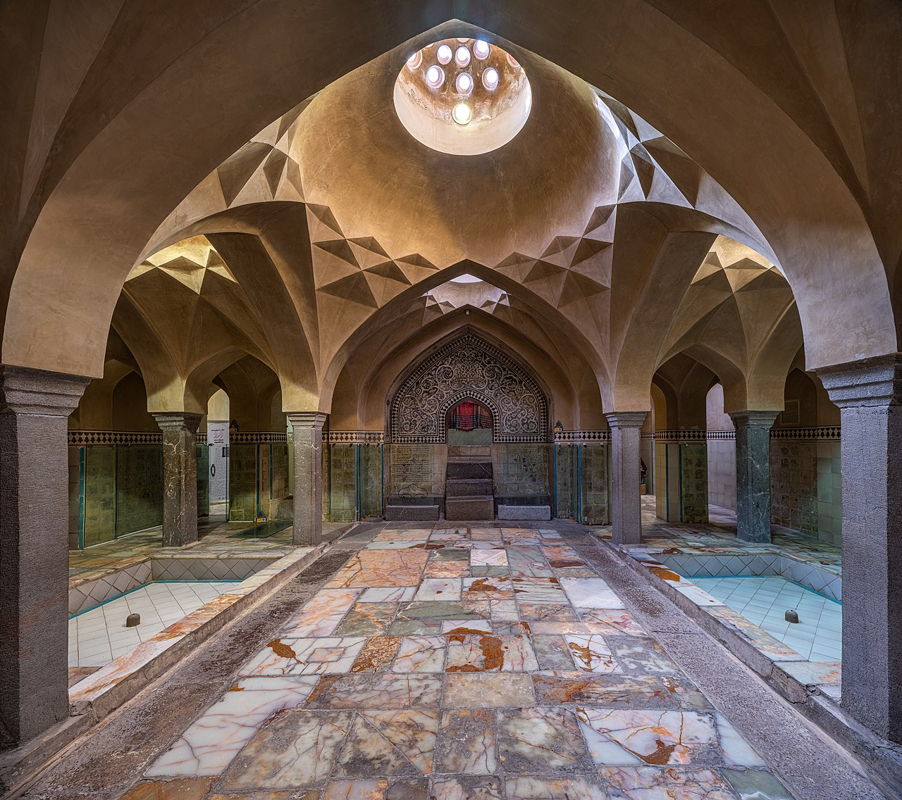
Healing Wounds
Health + Wellness Center
05.10.21
Alex Coelho - Juan Cruz - Georgina Giassia - Thomas Lindemann – Tim Schumann

Slide 2
Structural Logic & Analysis

Slide 3
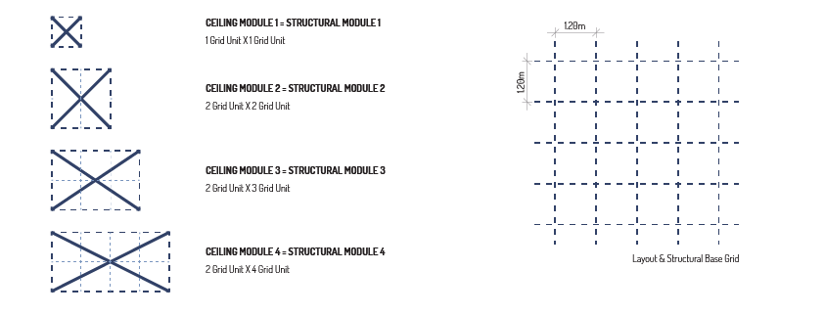
Structural Design Logic

Slide 4
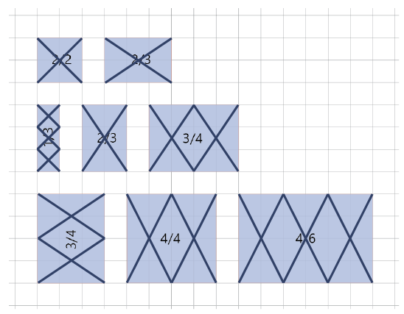
Structural Design Logic
Room standard layouts/configurations.
Few Structural modules which are combined to assemble rooms of different sizes.
Square module 1x1, 2x2 and 4x4
Rectangular module 2x3 and 3x4

Slide 5
Structural Analysis
Step 1:
Analyse the four structural modules individually as shells – i.e. walls and ceiling combined as one element.
Methodology:
- For each module two attempts of dynamic relaxation to study the ideal height of the ceiling.
- For each alternative two options for wall thickness based on the tartan grid – half or full (22.50cm or 45cm)
Output:
- Ideal ceiling form to minimise tension stresses.
- Three primitive construction lines of the approximated ideal roof – two diagonal ribs and one roof profile.

Slide 6
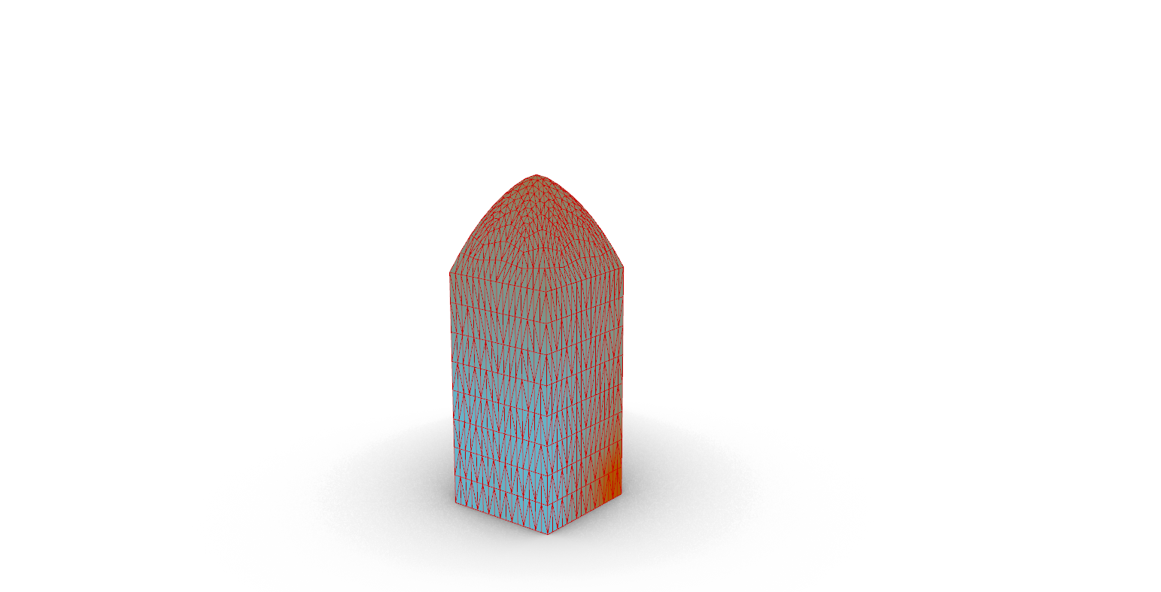
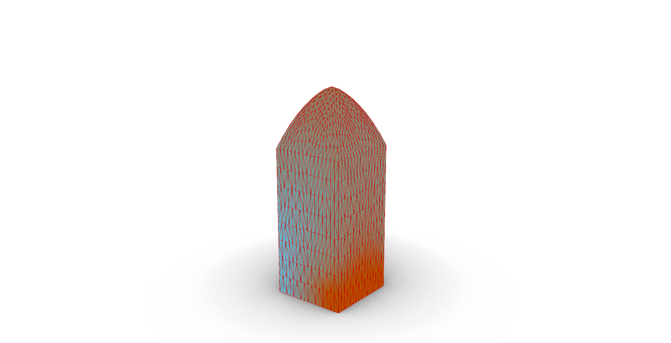
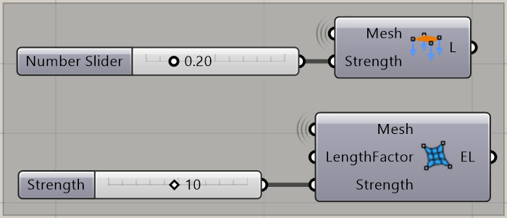
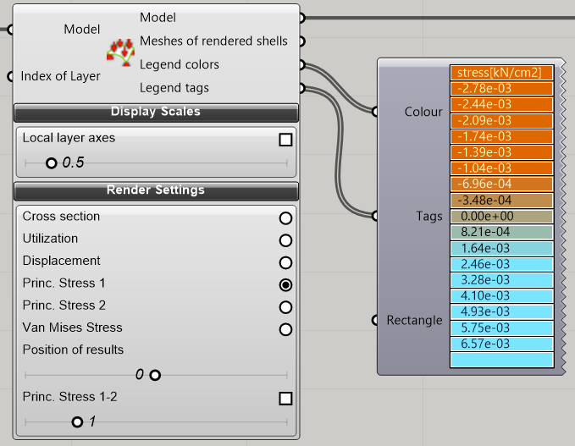
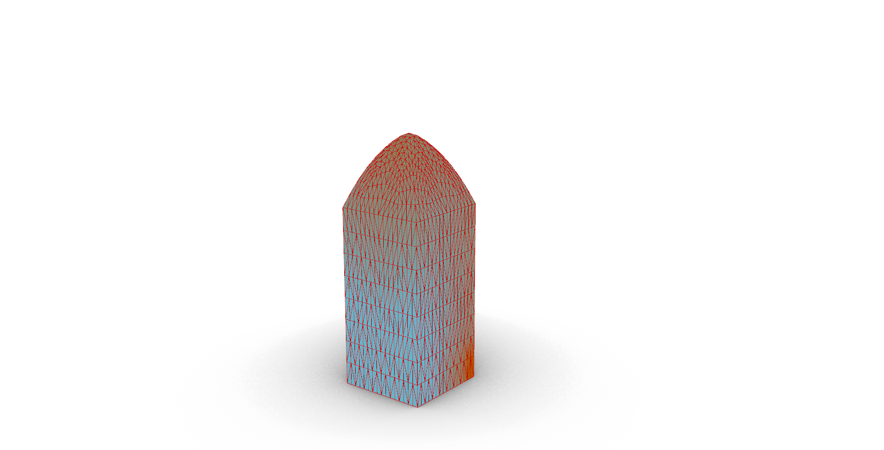
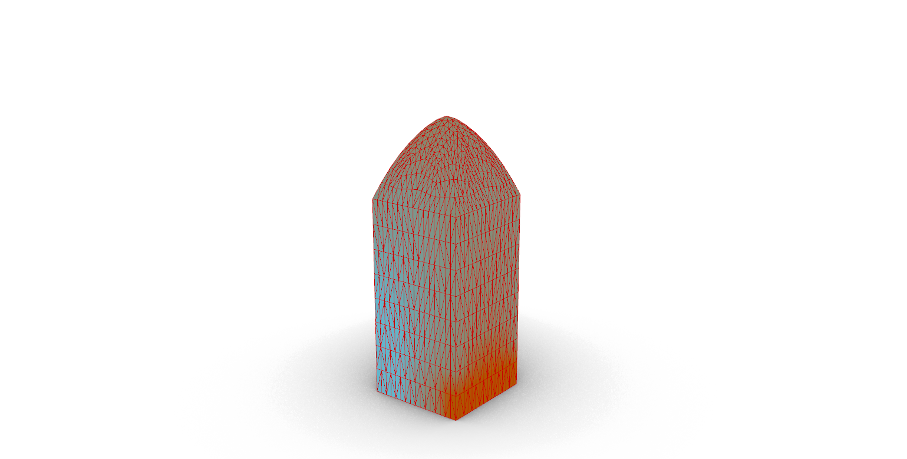
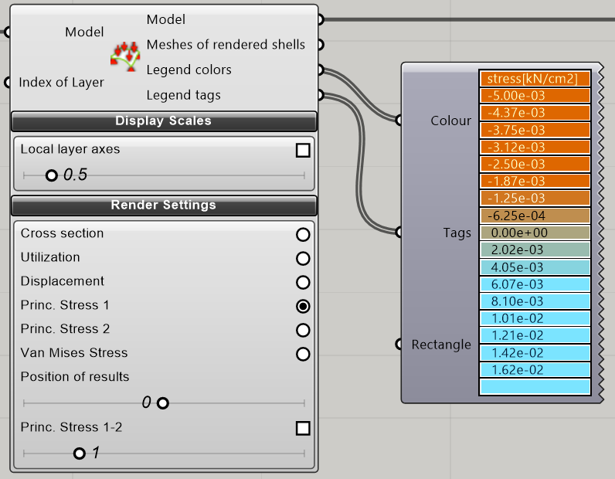
Structural Analysis
Backward side
Windward side
STRUCTURAL MODULE 1
1X1 Grid Unit – Low Ceiling

Slide 7
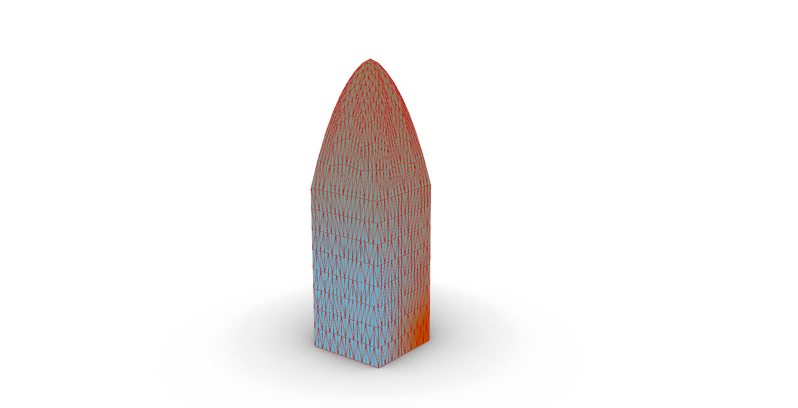
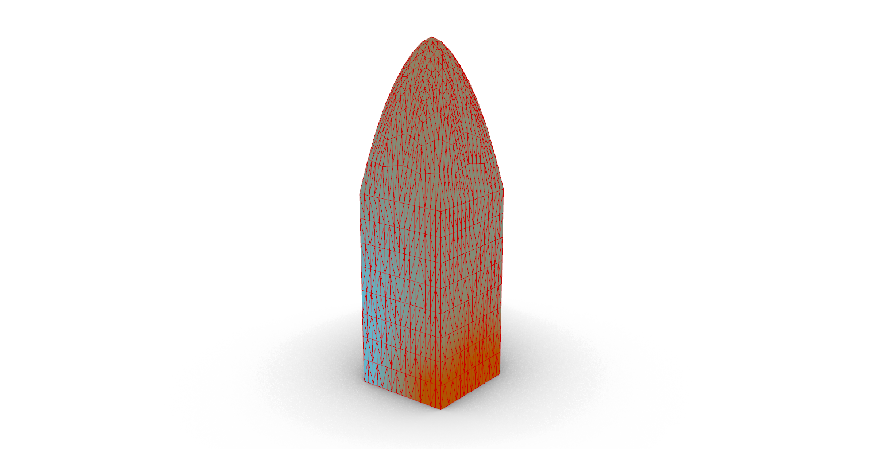
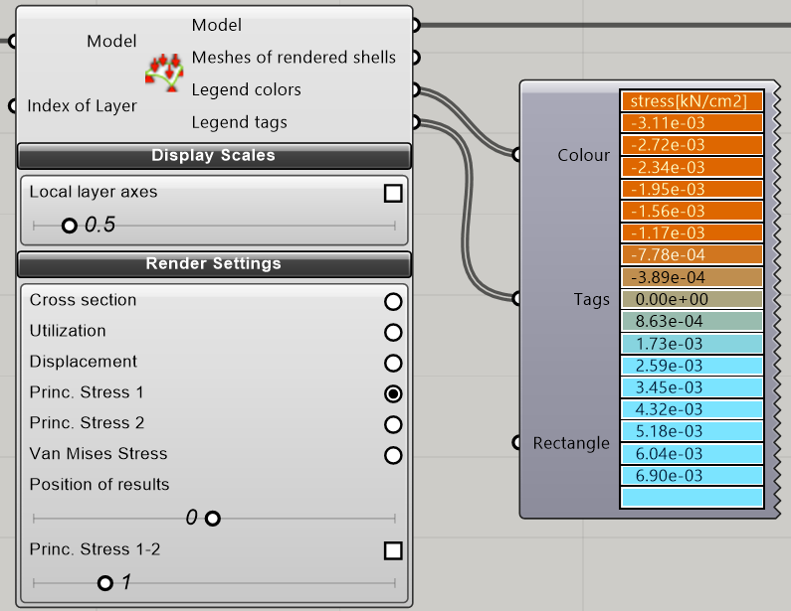
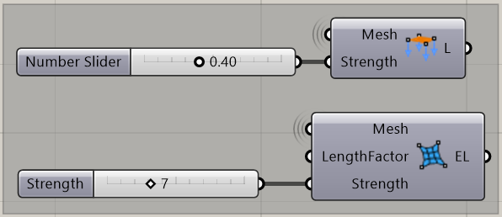
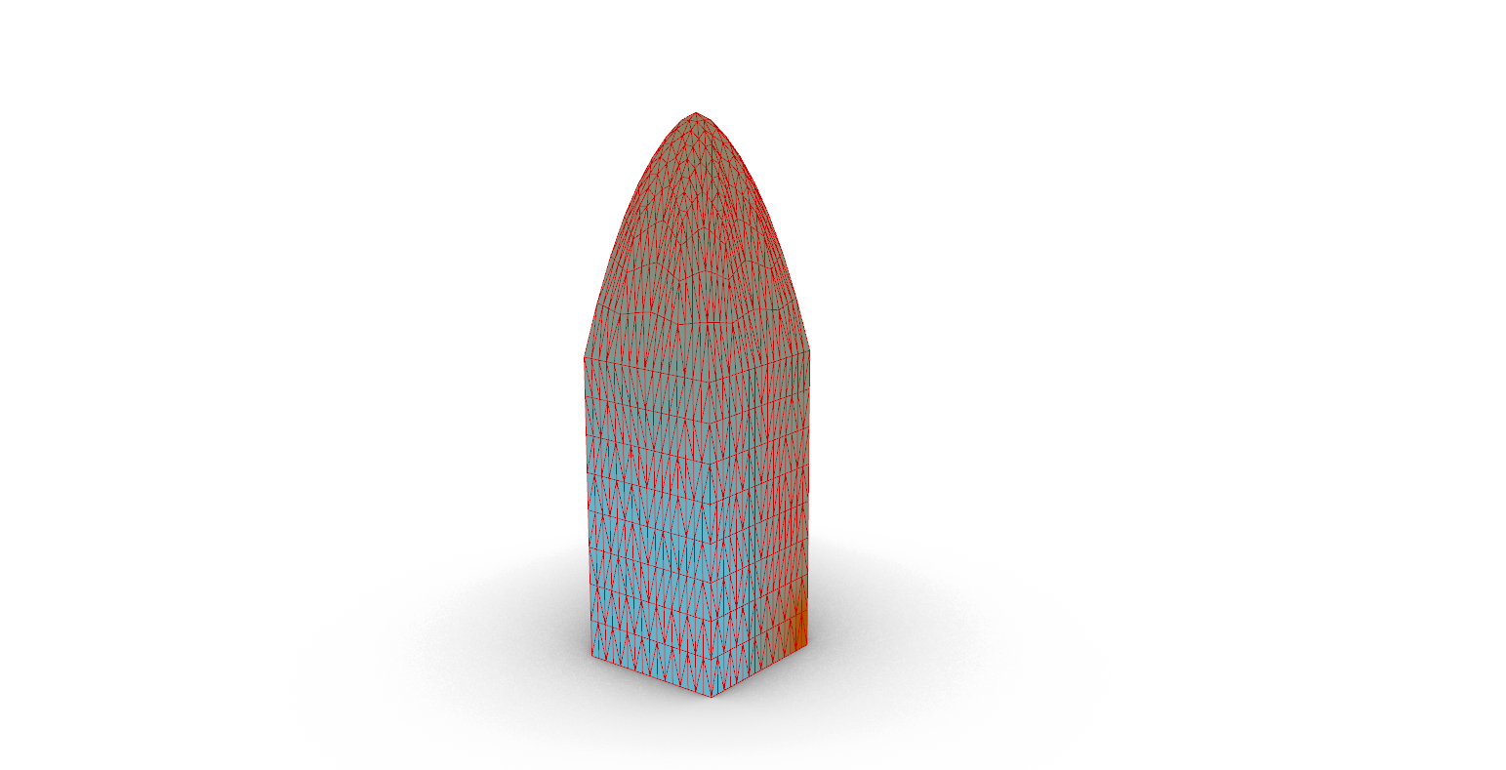
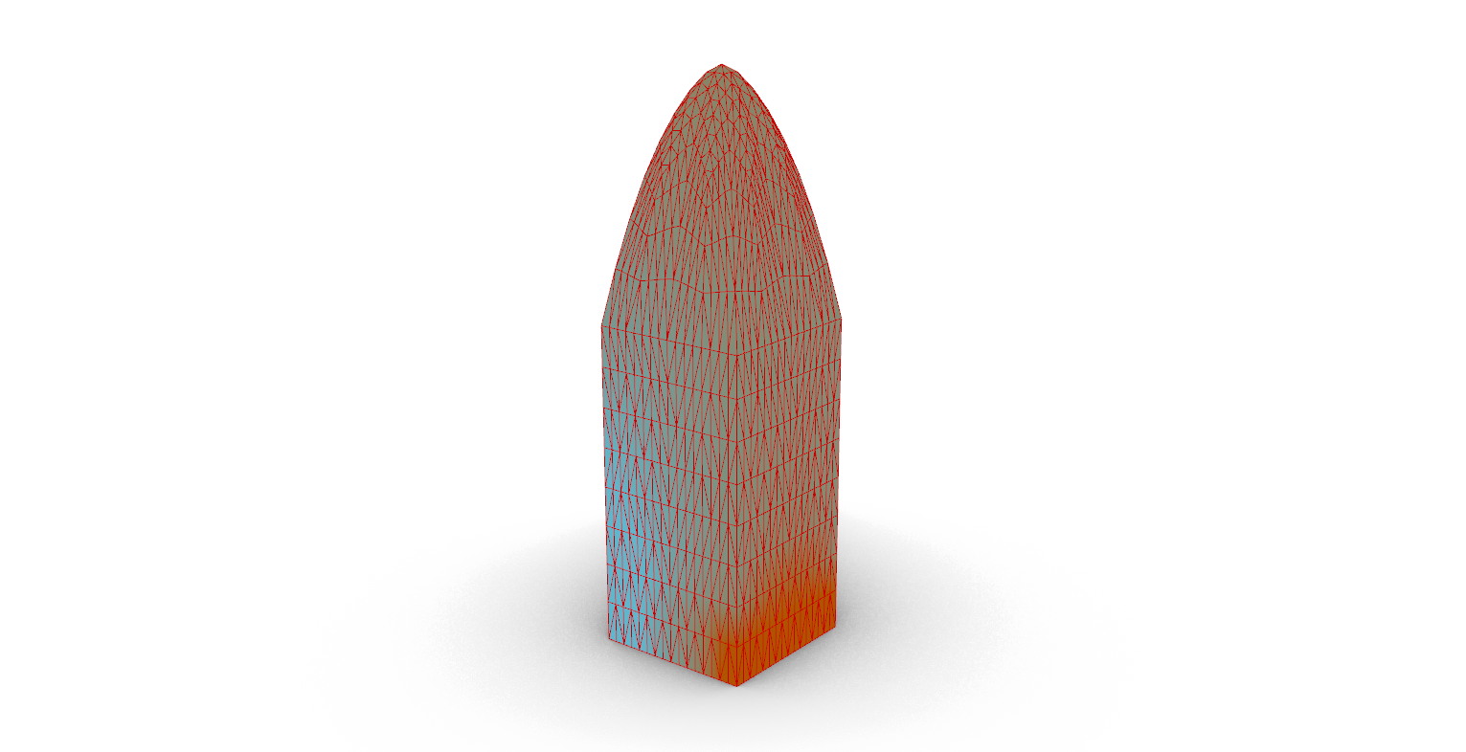
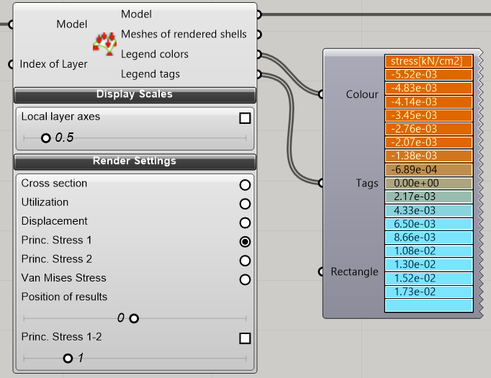
Structural Analysis
Backward side
Windward side
STRUCTURAL MODULE 1
1X1 Grid Unit – High Ceiling

Slide 8
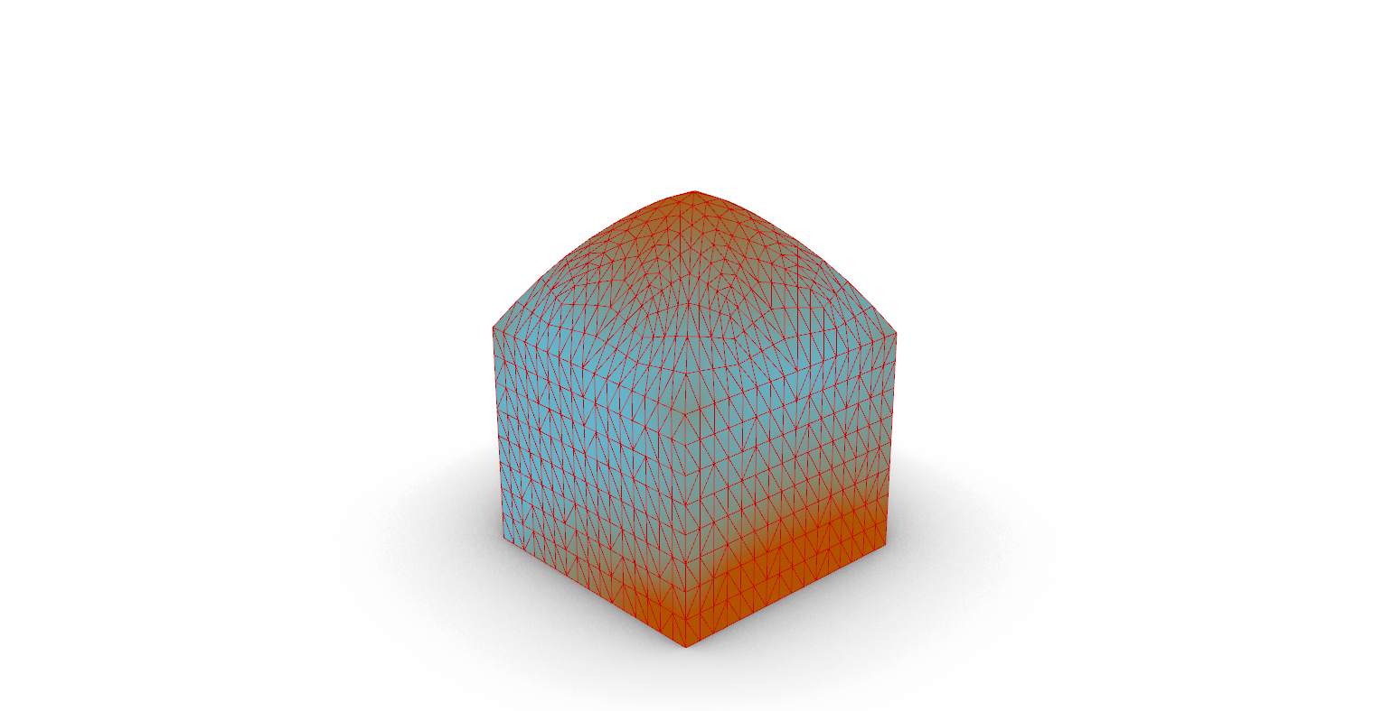
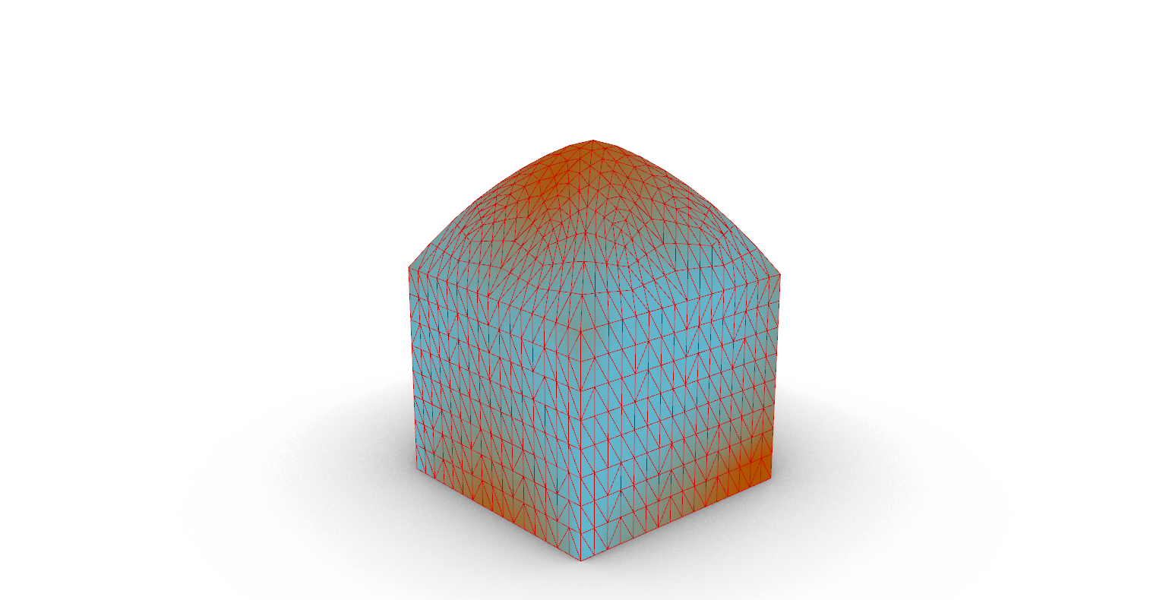
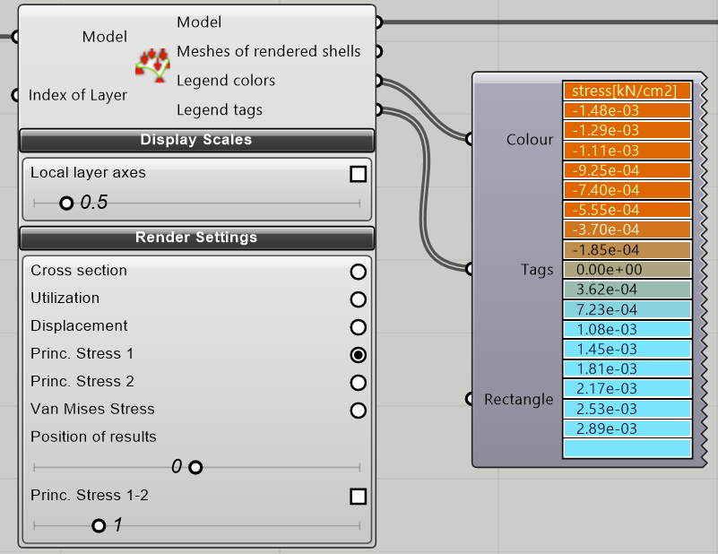
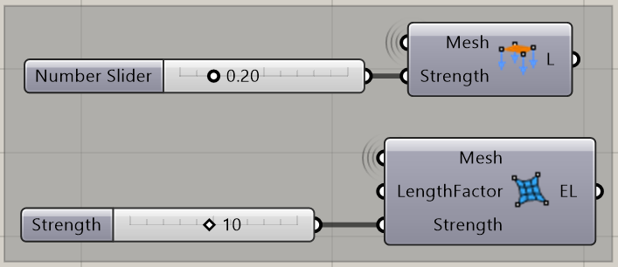
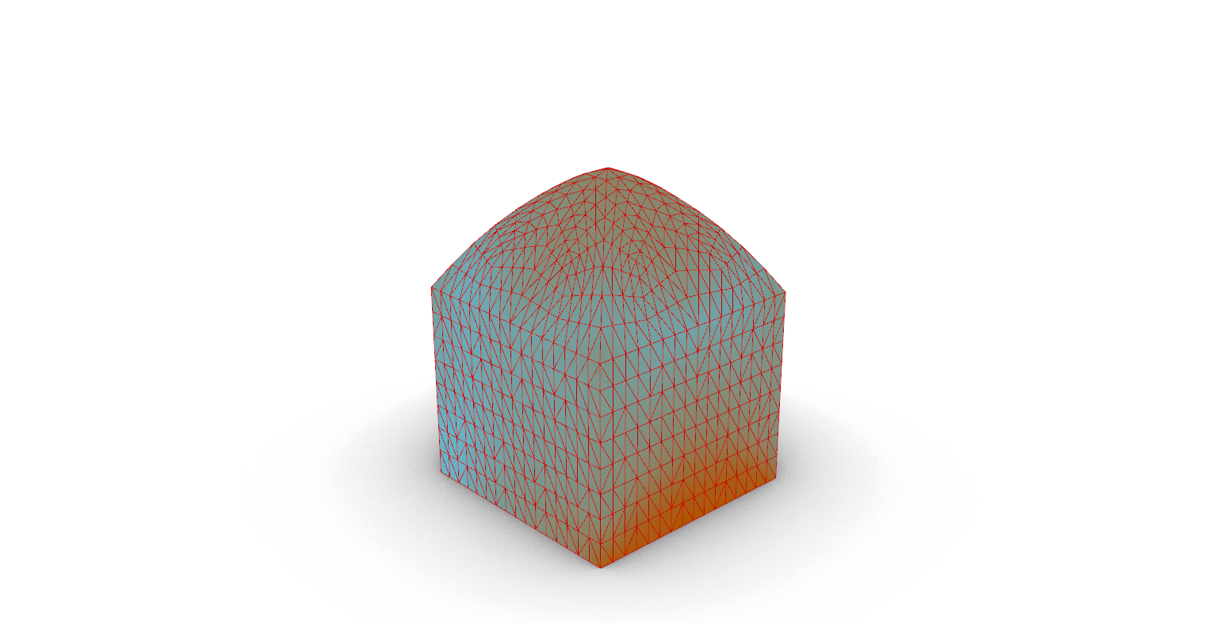
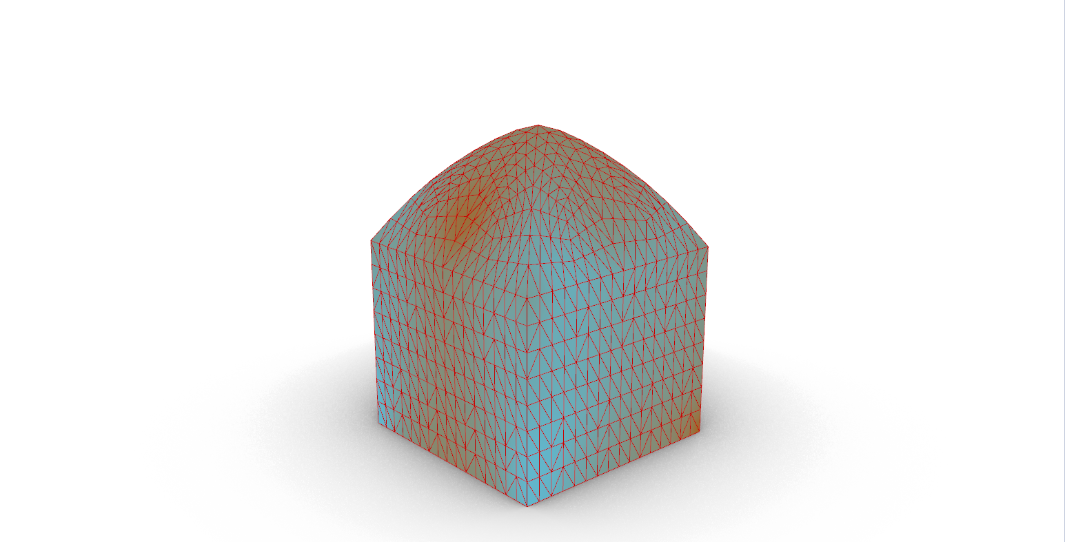
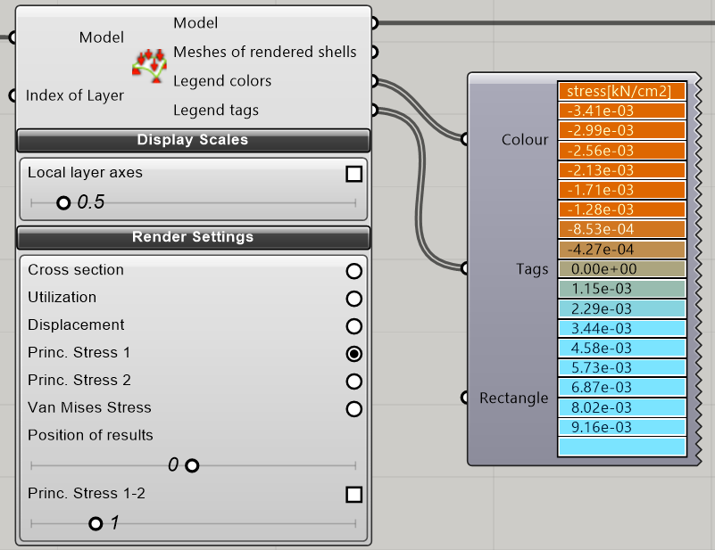
Structural Analysis
Backward side
Windward side
STRUCTURAL MODULE 1
2X2 Grid Unit – Low Ceiling

Slide 9
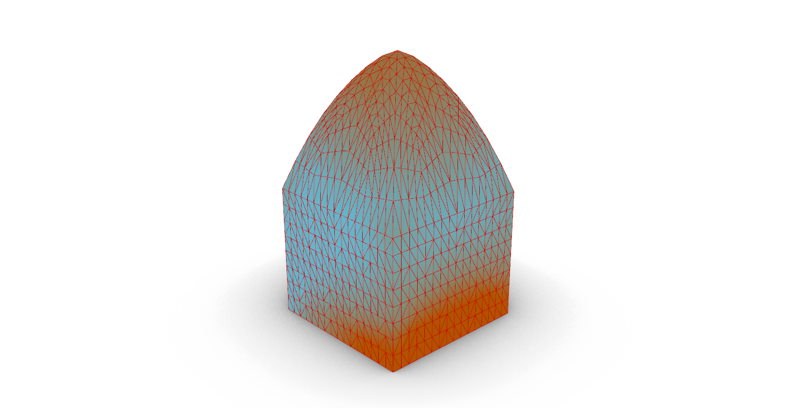
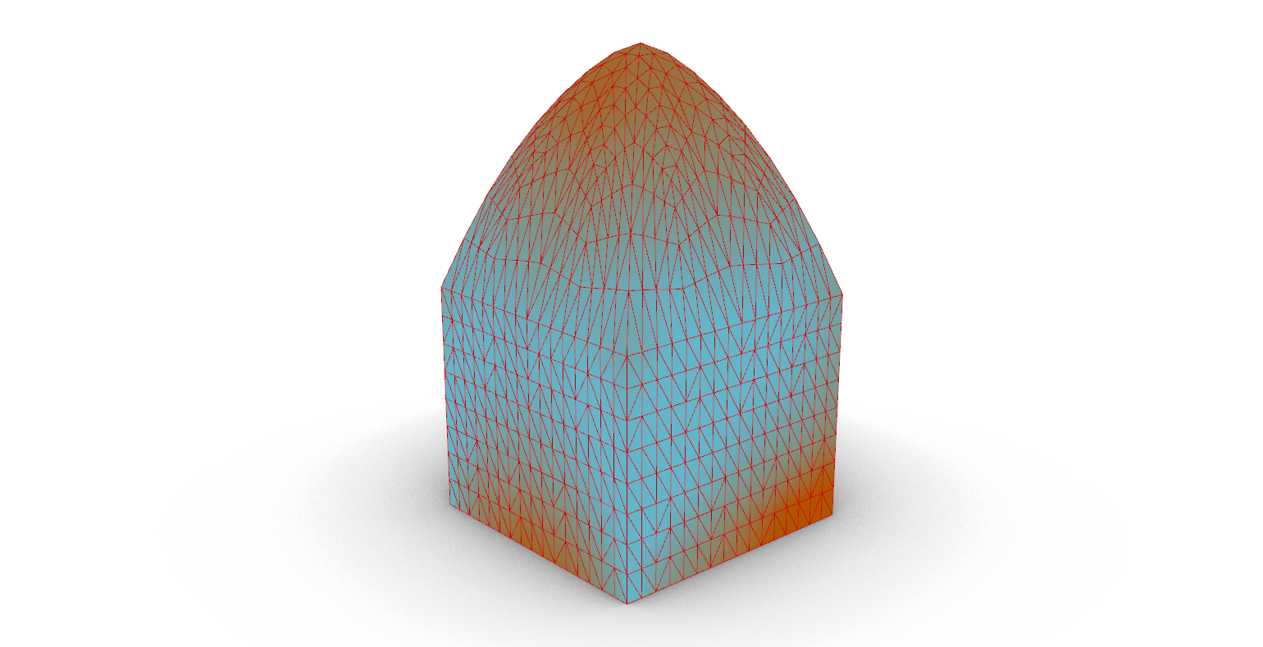
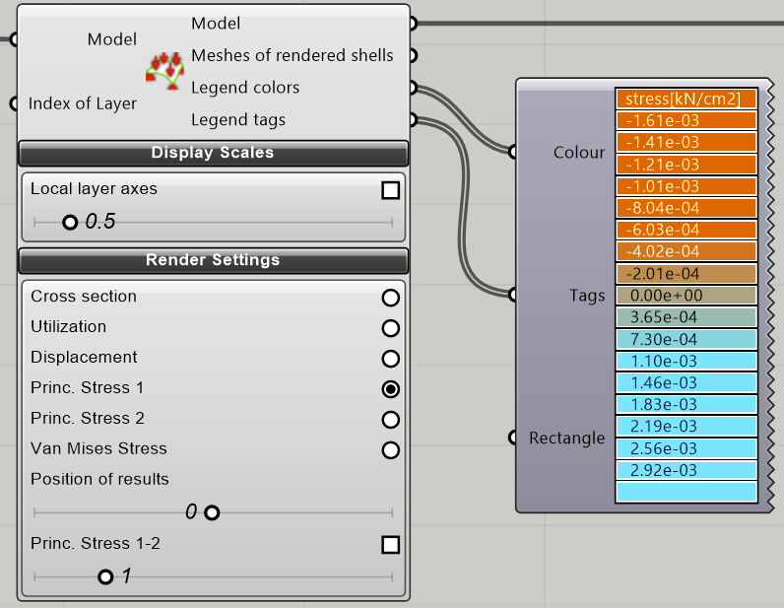
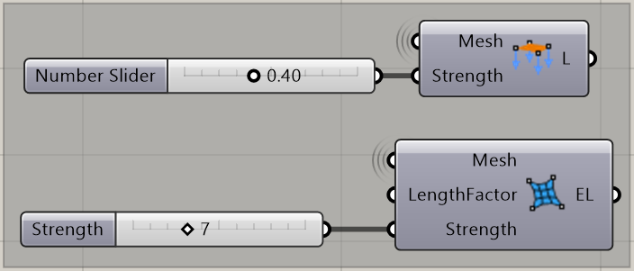
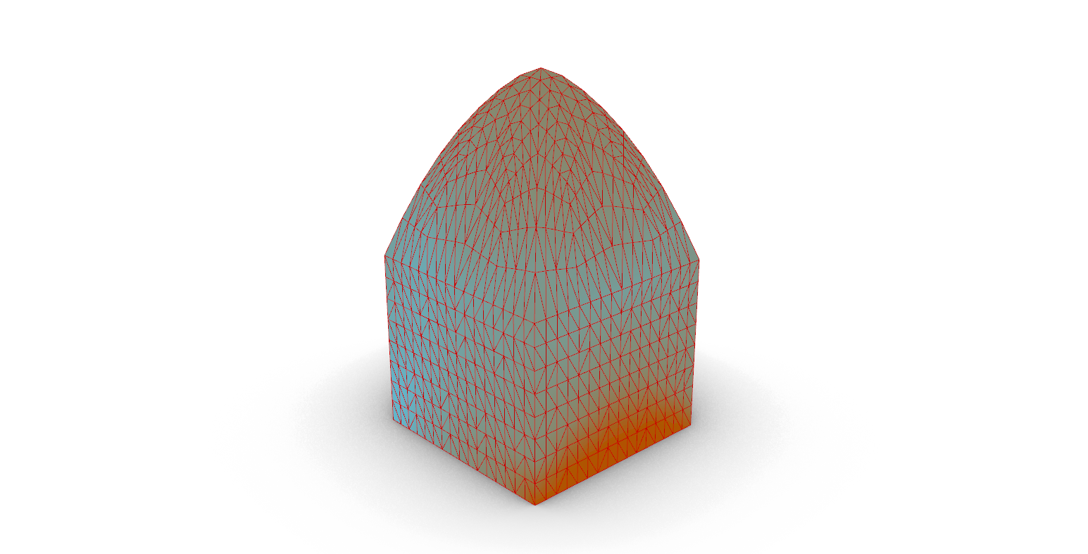
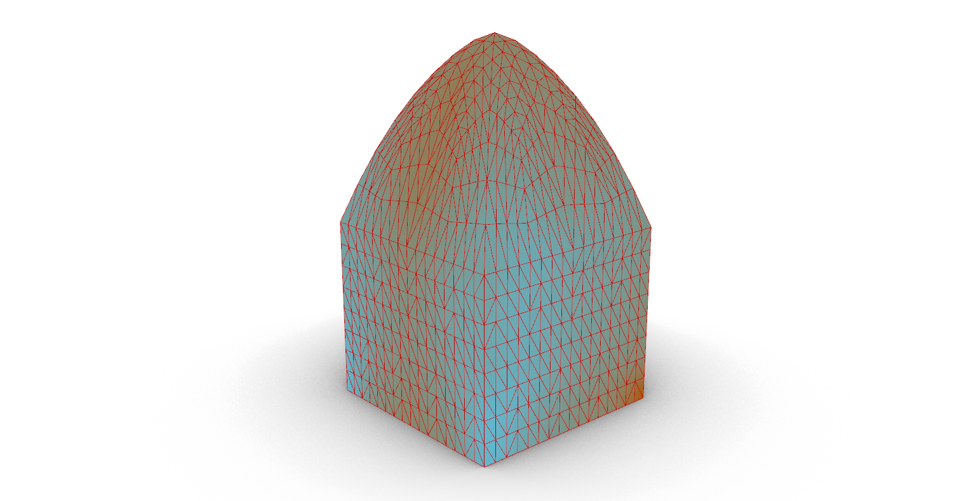
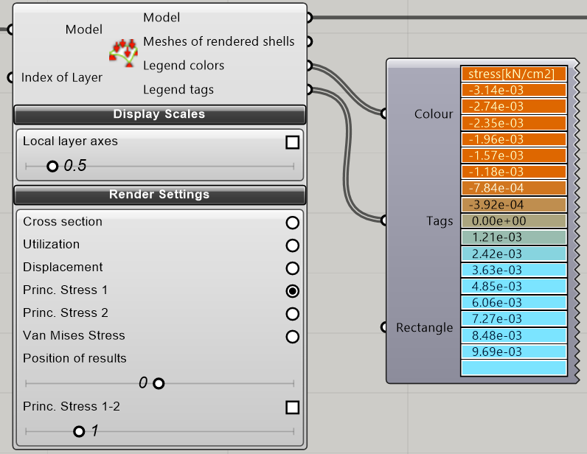
Structural Analysis
Backward side
Windward side
STRUCTURAL MODULE 1
2X2 Grid Unit – High Ceiling

Slide 10
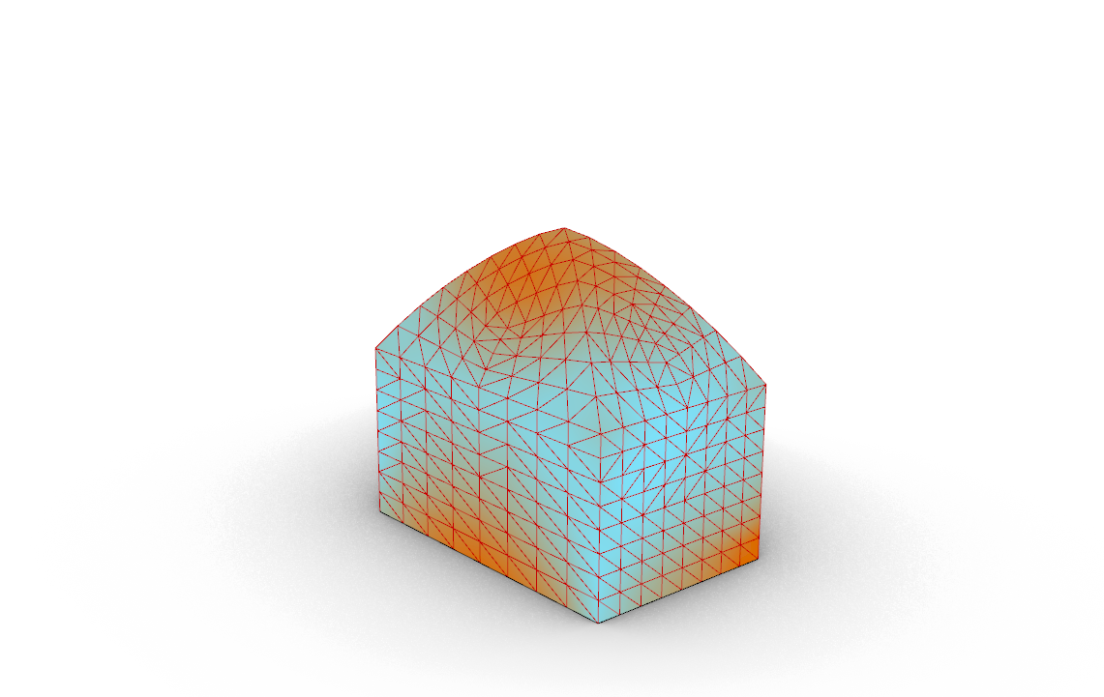
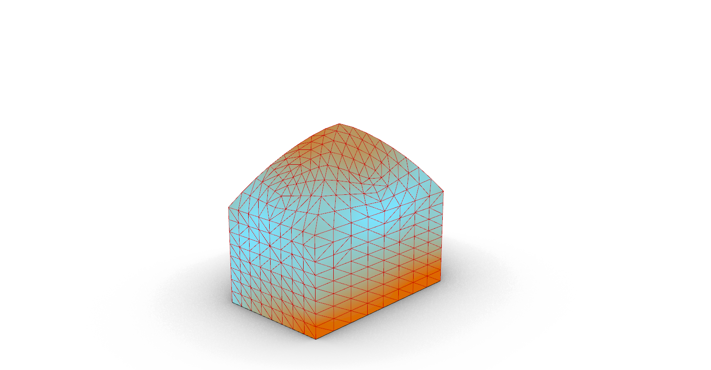

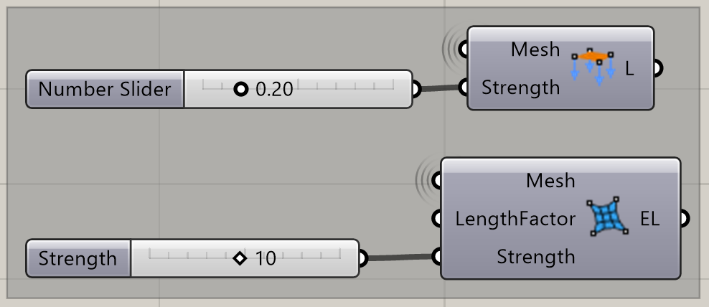
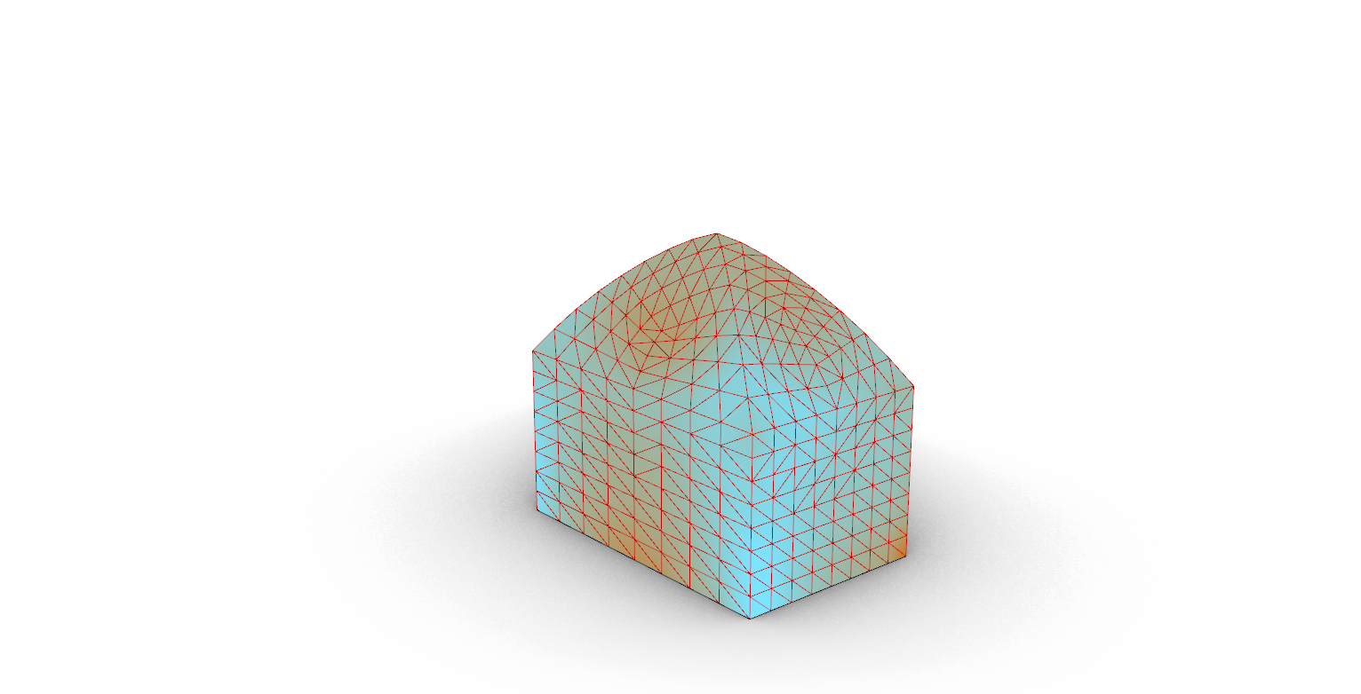
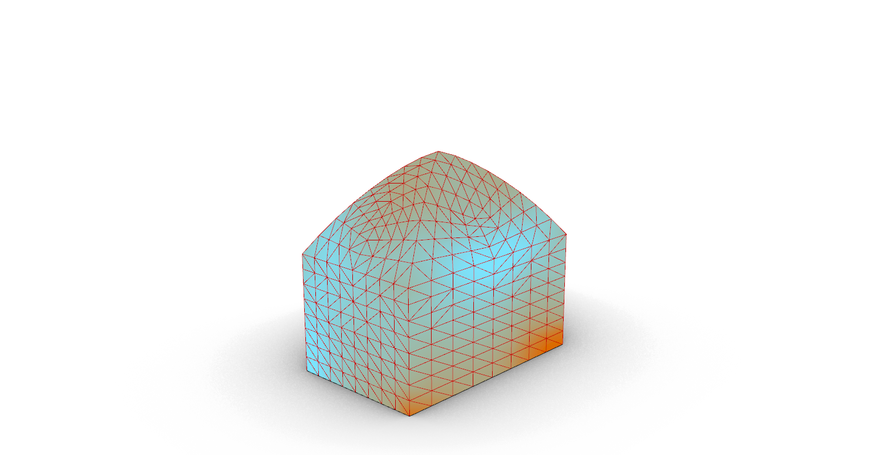
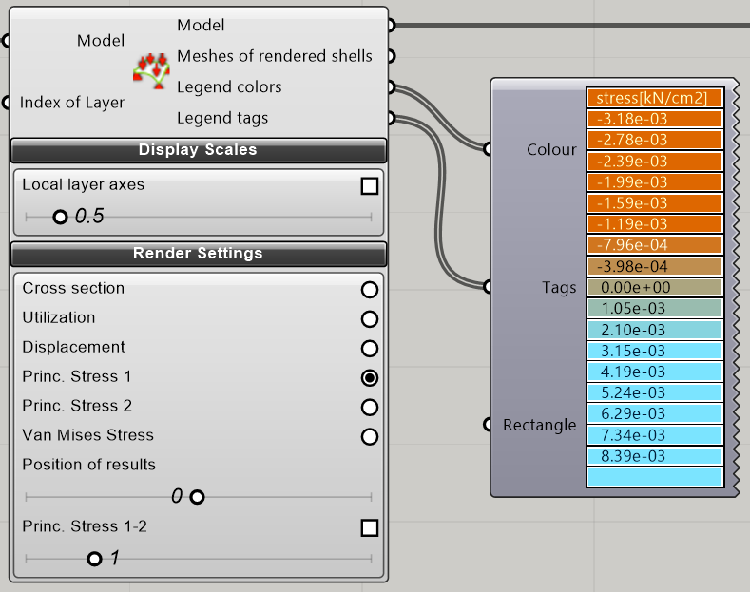
Structural Analysis
Backward side
Windward side
STRUCTURAL MODULE 1
2X3 Grid Unit – Low Ceiling

Slide 11
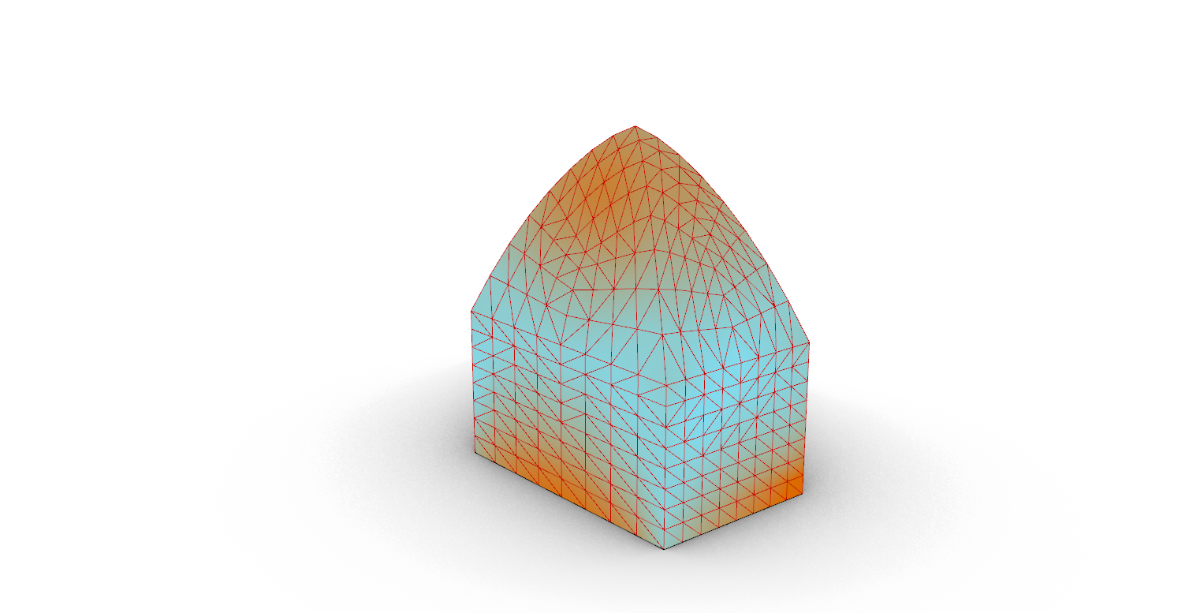
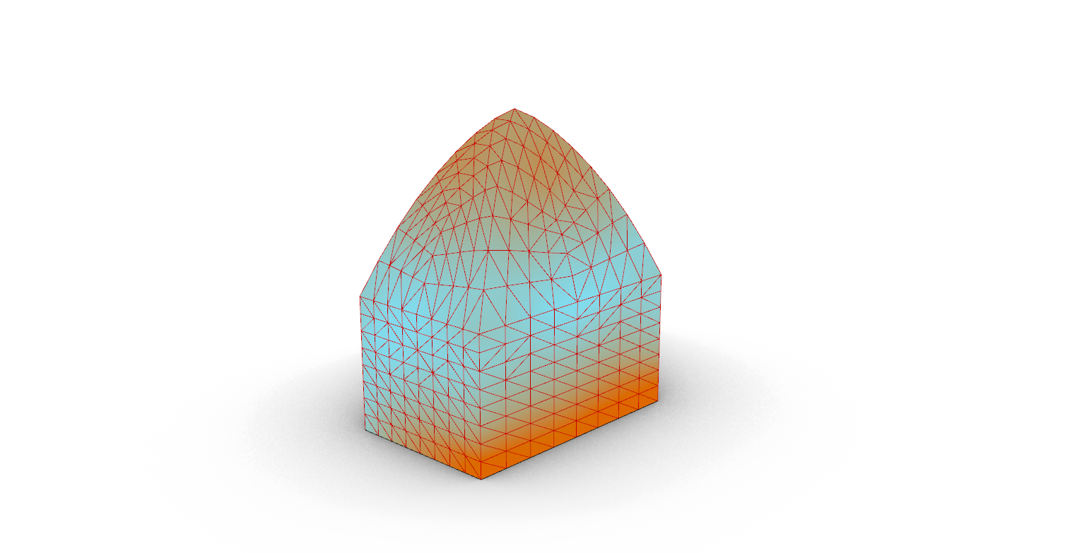
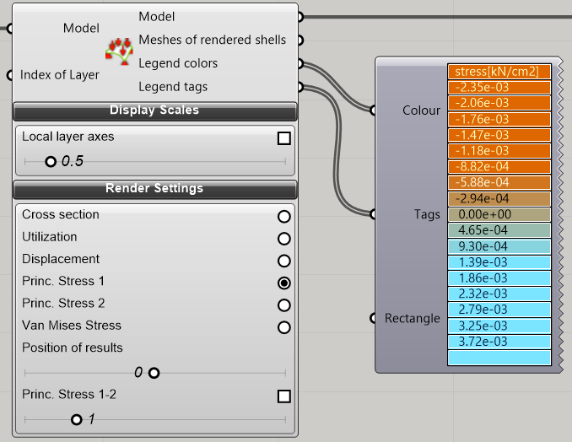
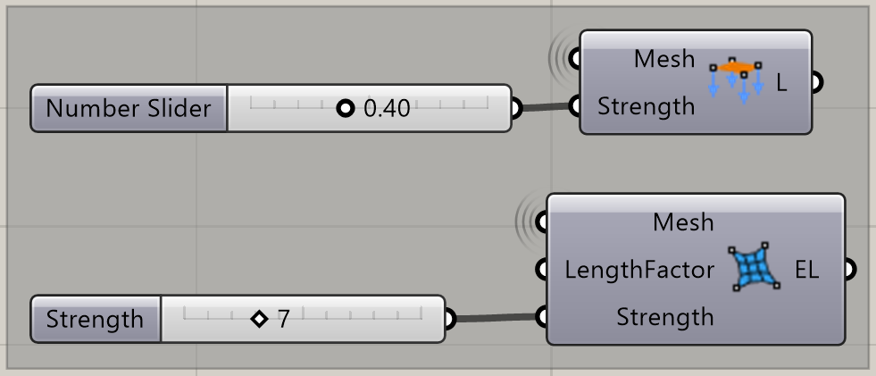
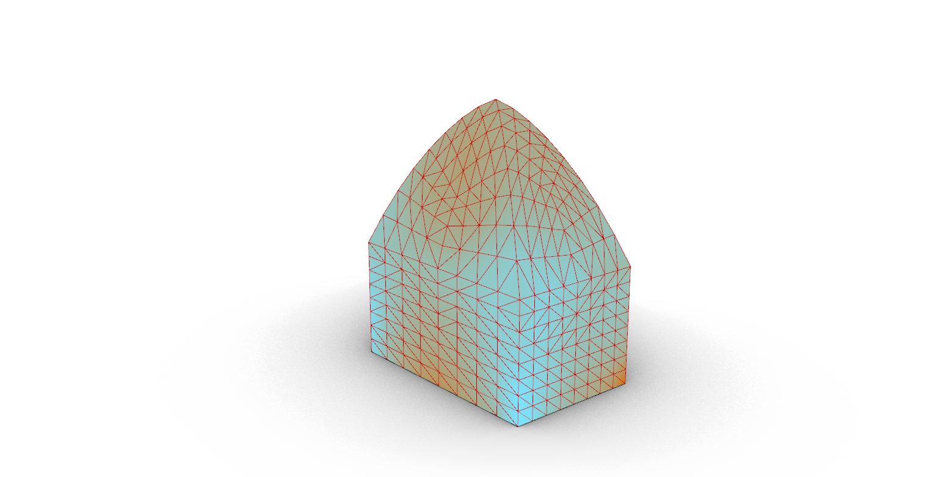
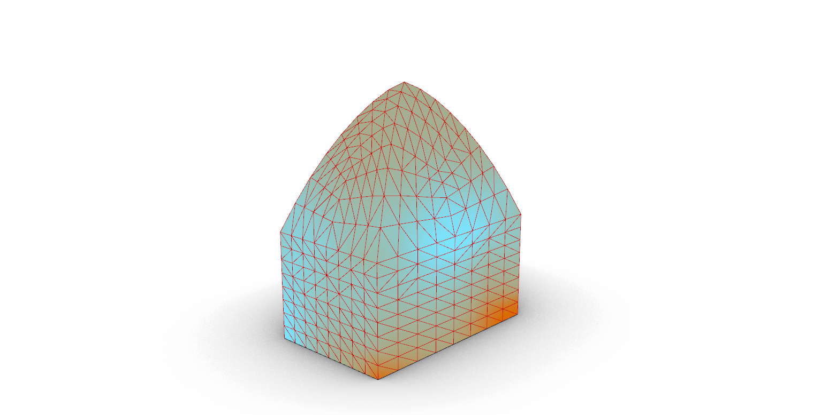
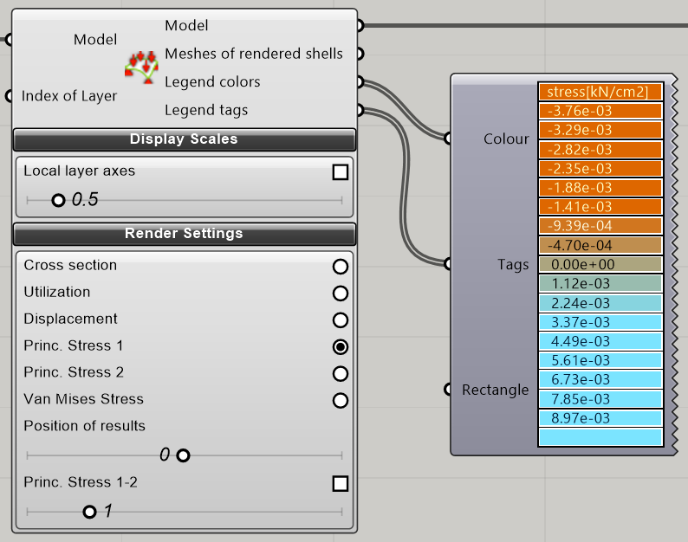
Structural Analysis
Backward side
Windward side
STRUCTURAL MODULE 1
2X3 Grid Unit – High Ceiling

Slide 12
Healing Wounds
Health + Wellness Center
Midterm Presentation
Alex Coelho - Juan Cruz - Georgina Giassia - Thomas Lindemann – Tim Schumann

